Slide 1
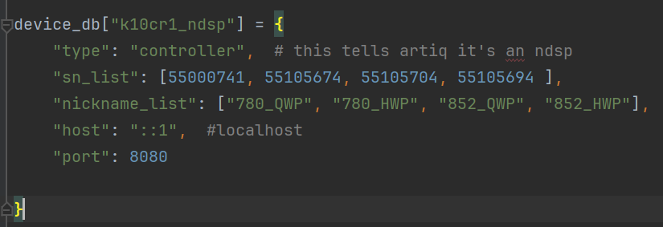
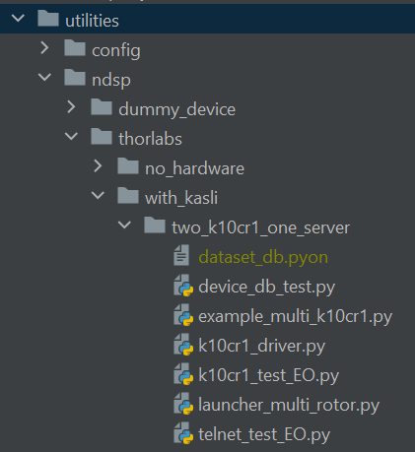
How to connect K10CR1 devices as NDSP
In device_db.py:
First, update your device_db.py file:
S/N of K10CR1 devices
Nickname for each device
Distinct port number for the server.
*Note: Port 8080 is reserved for ndsp devices in our setup.
Second, run the launcher_multi_rotor.py in another conda prompt to establish a server.
Ex) How to run launcher file in Node2:
open a conda prompt
cd C:\Networking Experiment\artiq codes\artiq-master\repository\qn_artiq_routines\utilities\ndsp\thorlabs\with_kasli\two_k10cr1_one_server
conda activate artiq7
python launcher_multi_rotor.py
Defines the Driver class for your K10CR1 devices
Launches a server that will manage multiple K10CR1 devices

Slide 2
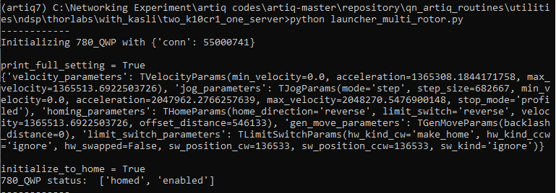
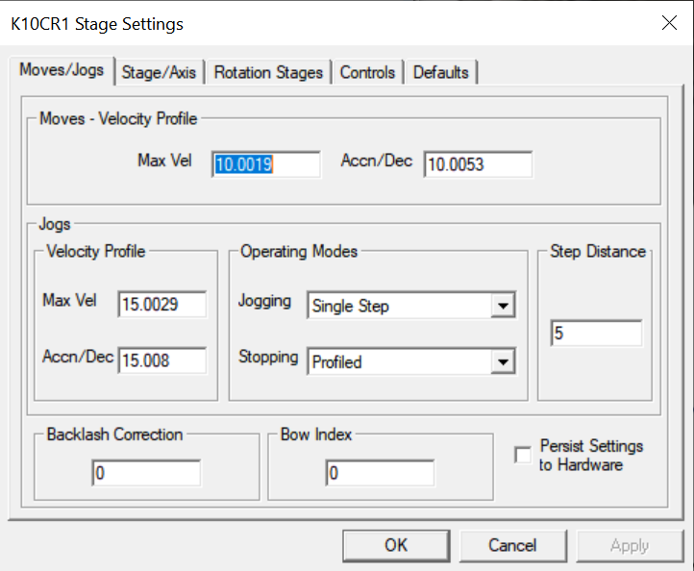
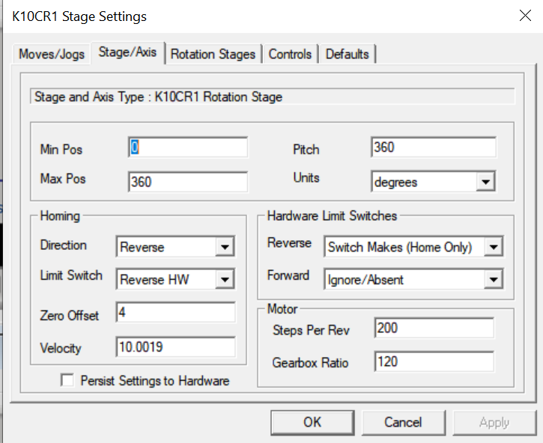
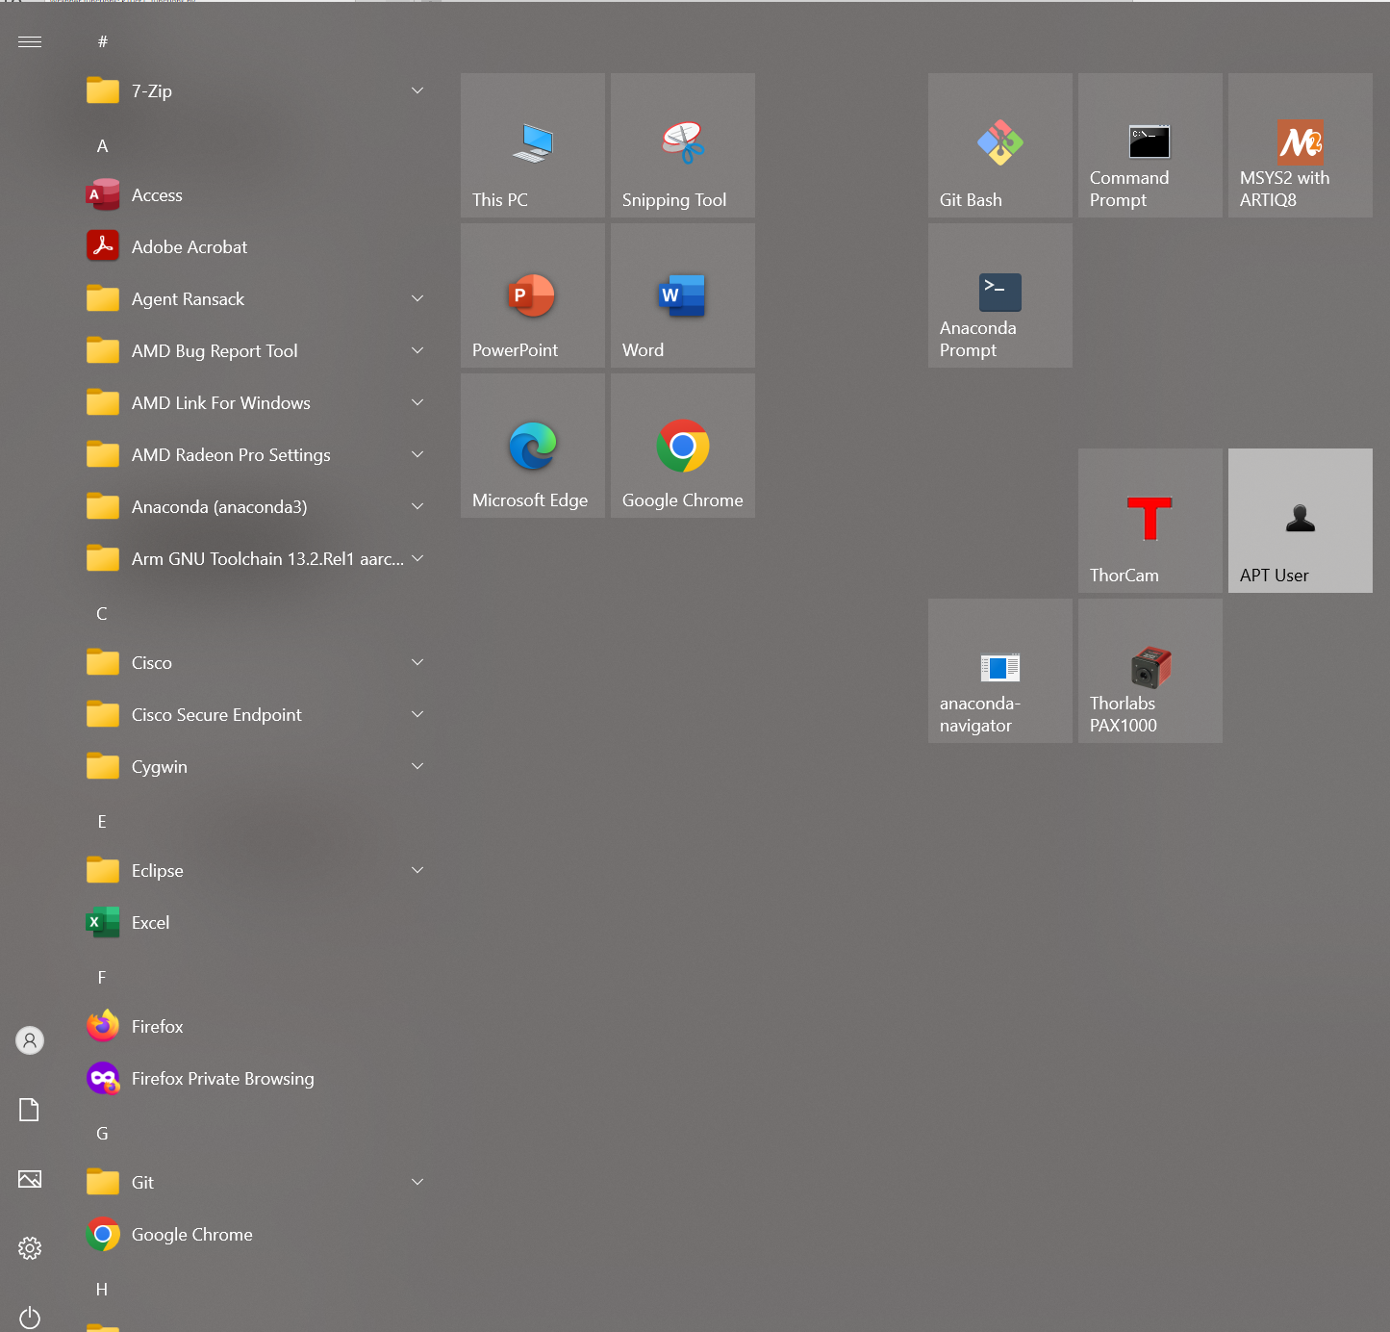
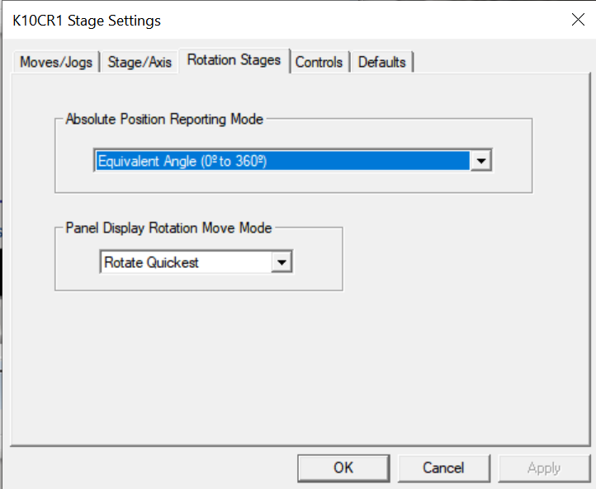
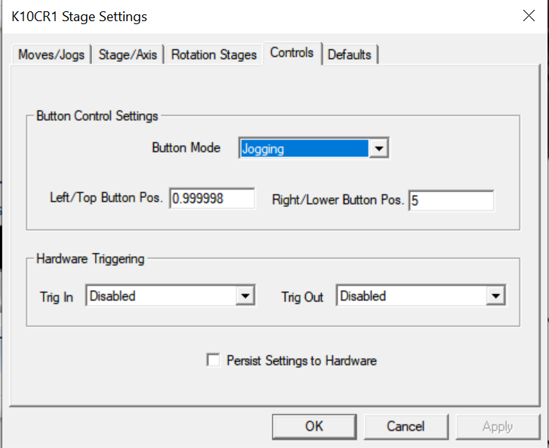
K10CR1 device initialization
Running launcher_muli_rotor.py in conda prompt:
If the device is newly integrated to the setup,
  Check if the printed parameters(velocity, acceleration, etc) are similar to what we have on the right.
If not, to ensure consistent behavior of the waveplate rotators used in the experiment, it is important to set the stage settings identically. The stage settings can be changed with the Thorlabs software -APT user.
Changing the stage settings with APT user:
Run this program.
Change the stage settings of the connected devices as the following:

Slide 3
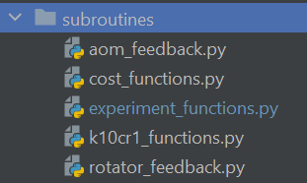
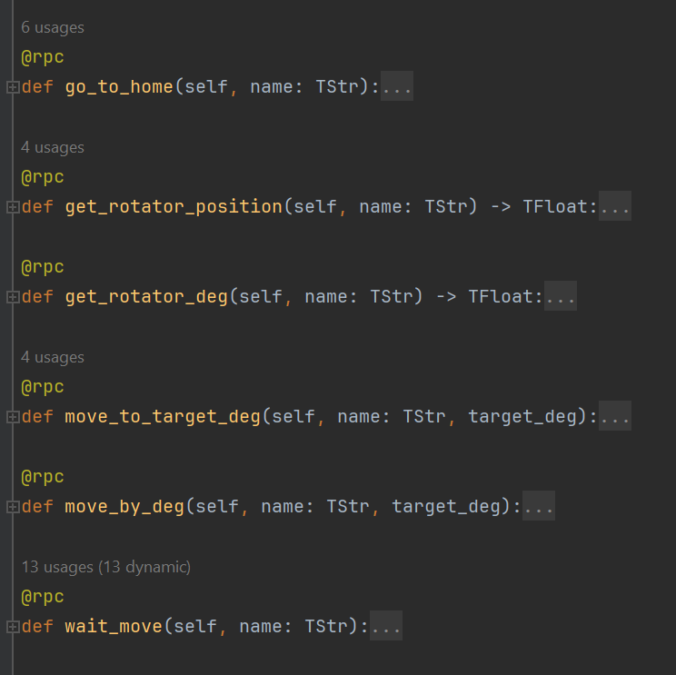
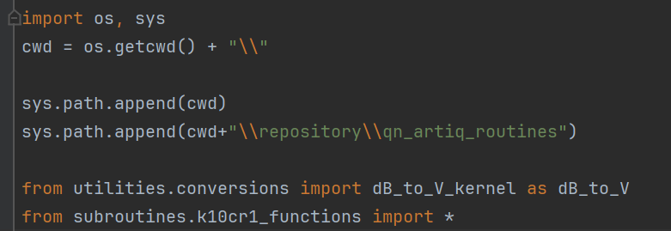
Wrapper functions: k10cr1_functions.py
Defines the wrapper functions to control K10CR1 devices.
Q. Why do we need wrapper functions? Why don’t we directly call NDSP functions?
A. if you want to call NDSP functions from the kernel and return things, you need to define wrapper functions. If you call the NDSP functions directly, you'll get an error saying that the expression of NoneType can't be unified with float (or whatever your return type is).
In k10cr1_functions.py:
@rpc decorator:
@rpc decorator is required when calling host functions from a kernel.
@rpc functions runs on the host PC, while the rest of the run() runs on the FPGA
Ex) How to import the functions in other files:
`

Slide 4
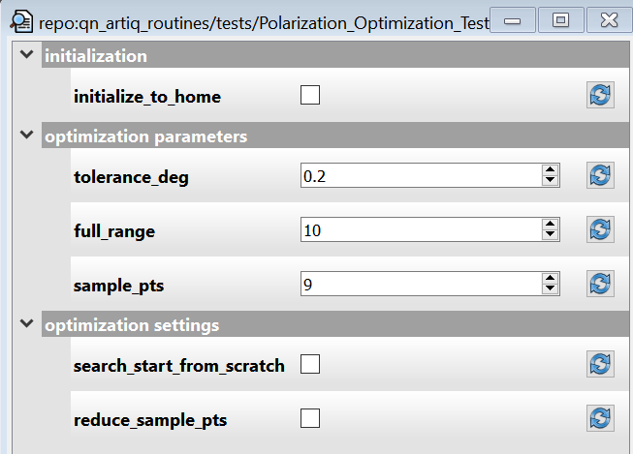
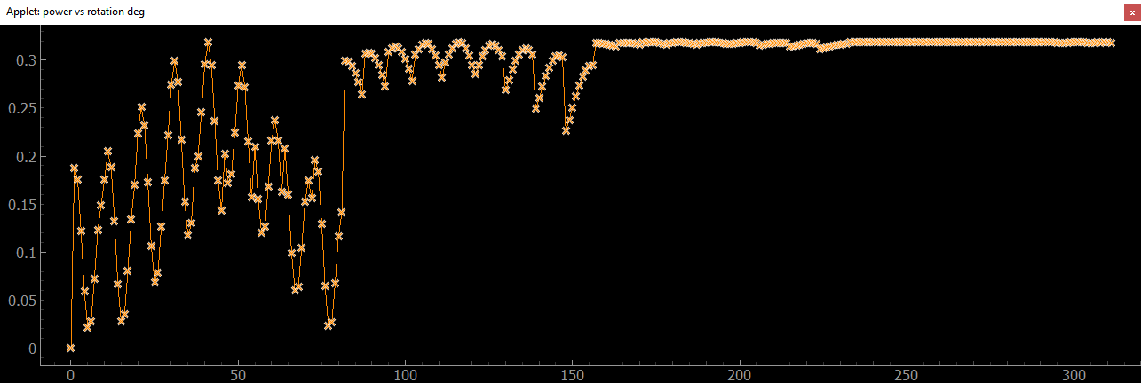
Polarization_Optimization_Test
file located at “qn_artiq_routines\\tests\\PolOptTest.py”
FORT polarization optimization code for Node1 and Node2 in Networking Experiment with a simple iterative approach.
Background:
In the networking experiment, FORT is launched on-chip inside the vacuum chamber. Therefore, we cannot directly align the polarization of the FORT at the atom. To align the polarization, we use the MM fiber which is located at the back of the parabolic mirror. There is a polarizer in front of the MM fiber which is aligned so that it transmits maximum power when aligned to |V>.
In this code, it iteratively finds the best QWP and HWP angles which maximize the transmitted power from MM fiber.
How does the code work?
Example run:
full_range = 10 deg
Search_start_from_scratch = False
starting from (0,0). it will search from (-5,-5) to (+5,+5) with steps = (full_range / sample_pts) until the tolerance is met.
If checked: Before starting the optimization, it initializes the waveplates to home.
Sets when to finish the iteration.
It will run until the step size (full_range / sample_pts) is less than the tolerance deg.
If checked: start searching from (0,0)
If not checked: start searching from the last optimized point. (best_852HWP_to_max, best_852QWP_to_max)
Reduces sample points as it proceed to the next iteration.
Full range = 90, sample point = 9
tolerance_deg = 0.2

Slide 5
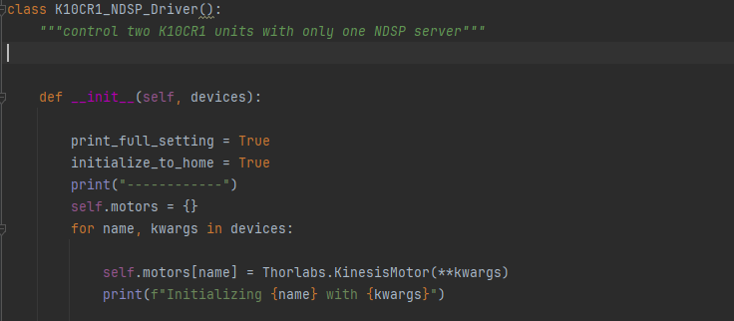
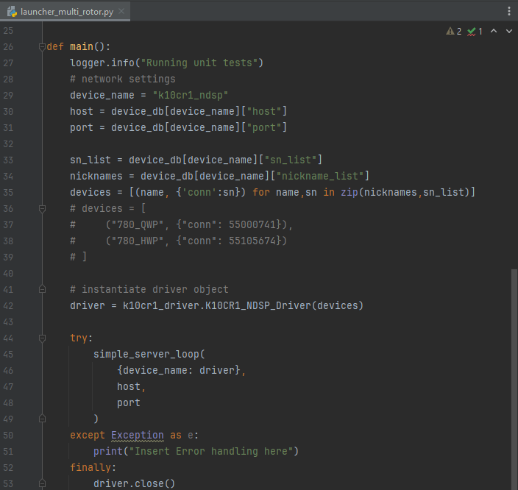
NDSP components – Driver and Launcher
1. Driver (k10cr1_driver.py)
Contains Python API functions to be called over the network
Performs I/O to the device
Top-level module of the driver should be called artiq.devices.xxx.driver
2. Controller (launcher_multi_rotor.py)
Instantiate, initializes and terminates the driver, and sets up the RPC server
Front-end command-line tool to the user
Should be called artiq.frontend.aqctl_XXX
setup.py entry must also be created to install it.
3. Client (Optional)
Connects to the controller and exposes the functions of the driver as a command-line interface
Front-end tools that have setup.py entries
Not necessary- generic sipyco_rpctool can be used instead of this.
Only required when there are amounts of data has to pass
4. Mediator (Optional)
Code executed on the client that supplements the network API
May contain kernels the control real-time signals
Simple devices use network API

